Slide 1



Development of a Blockchain-Based Gaming System
Done by:
Andronov M.D.
Abilov M.
Chiverdin E.A.
Research Supervisor:
Zhakypbekov S.Z.

Slide 2

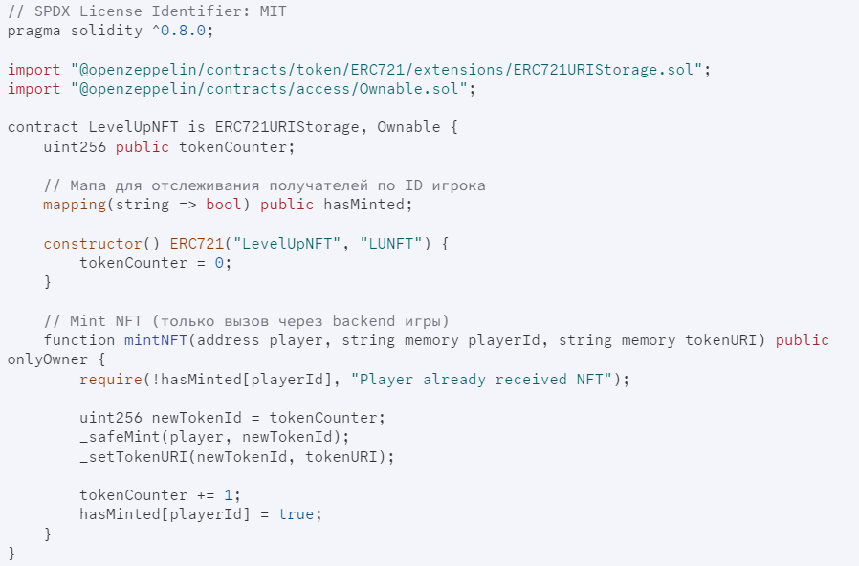
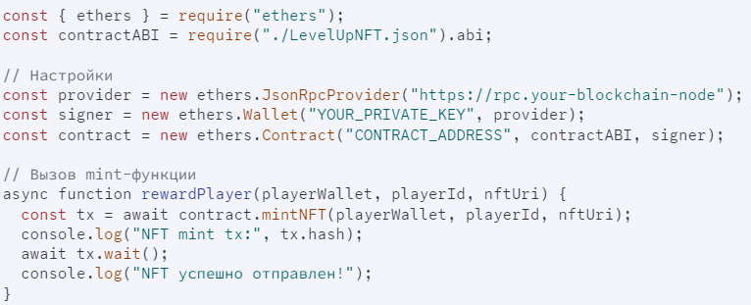
SOLIDITY, JS AND
FUNCTIONS
We use the Solidity language to write smart contracts. Smart contracts, in turn, are designed to automatically issue NFTs to our players.
The ERC-721 standard and the URI Storage extension are used for smart contracts. This allows each token (NFT) to have an individual link to its metadata.
Also, using JavaScript and its ethers.js library working with BSC, we create contract objects through which the main actions with the contract and the execution of its mint function are carried out.

Slide 3

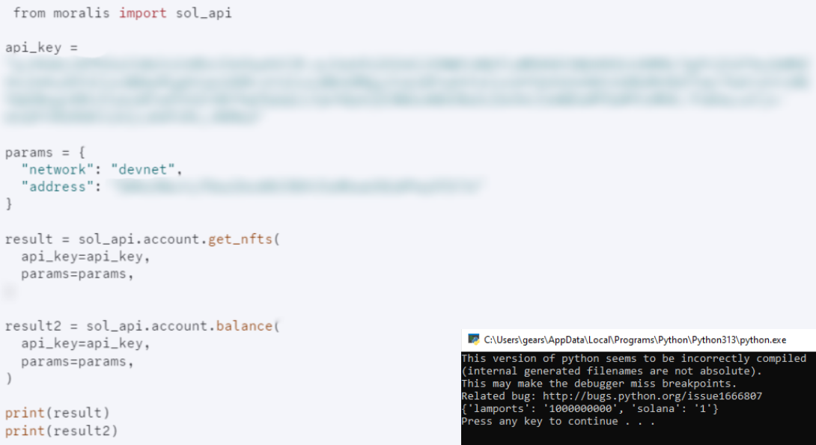
MORALIS AND
THE WALLET
To ensure our systems work properly, we use checks from the Moralis library via its API. This allows us to integrate a quick check of our users assets.
Based on this, we get a full list of NFTs and the player's wallet balance almost in real time,
which is very convenient for blockchain-based gaming systems.

Slide 4
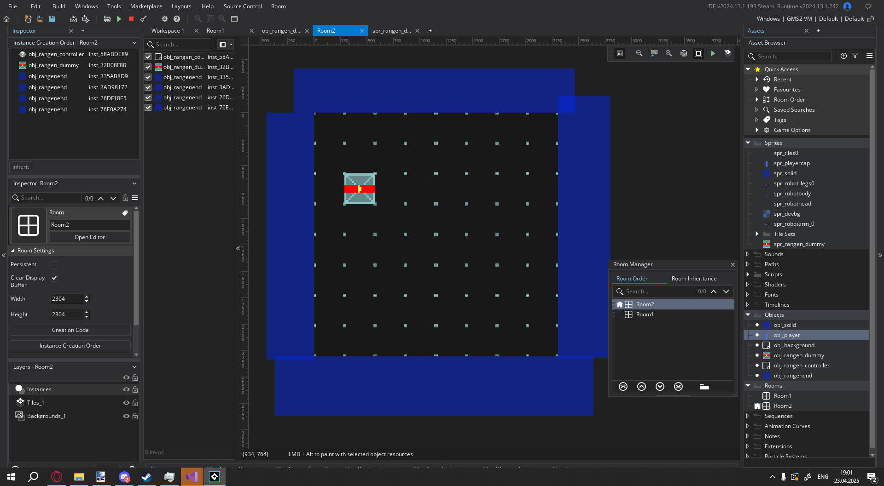
GAME ADVANTAGES
PROCEDURAL GENERATION

Slide 5
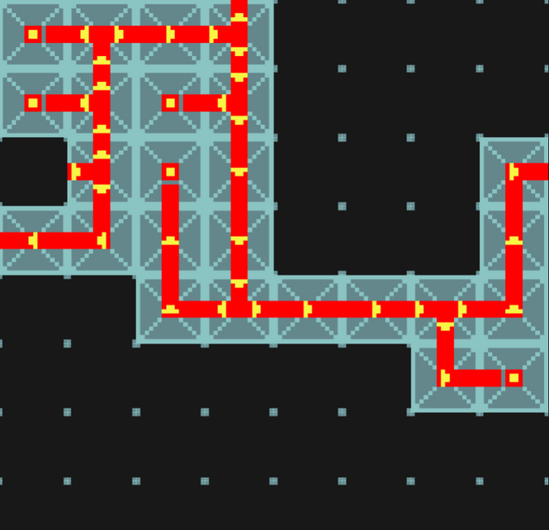
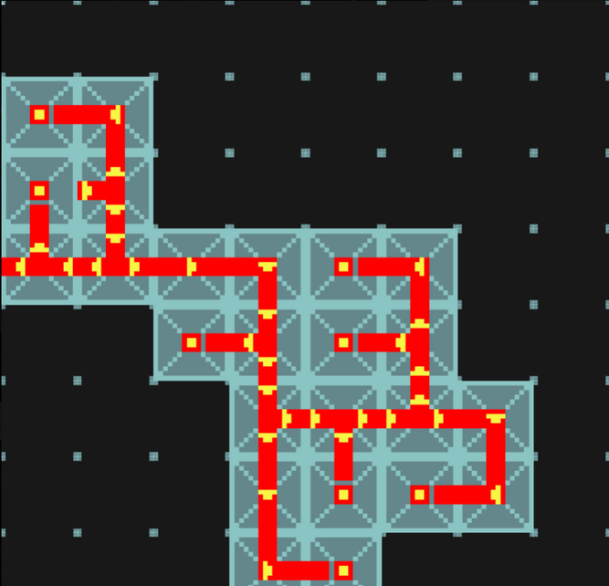
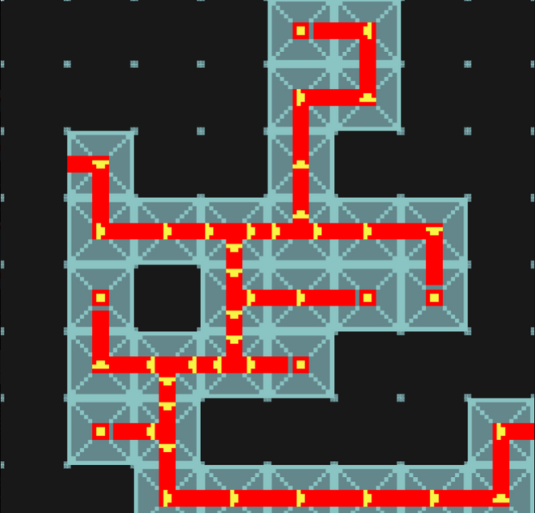
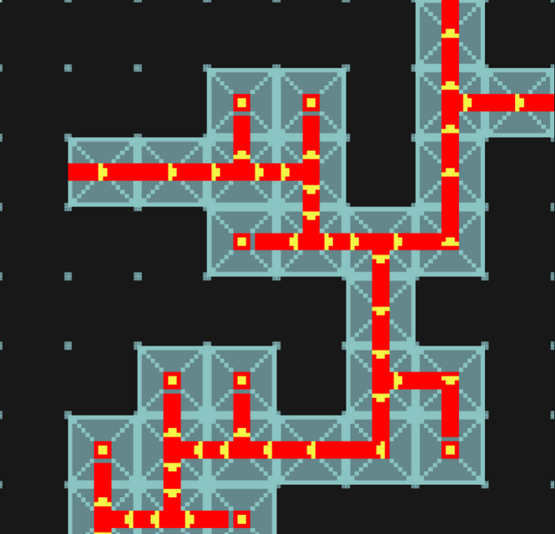
GAMEMAKER AND IT’S
POSSIBILITIES
Thanks to the capabilities of the GameMaker game engine, we were able to create procedural level generation for our game.
The game generates a level by building a simple map from the starting point, using various modules from straight corridors to branching climbs and L-shaped connections.
This allows us to significantly diversify the gameplay of our game and makes each level unique, but due to the pre-written restrictions - and short-lived.

Slide 6

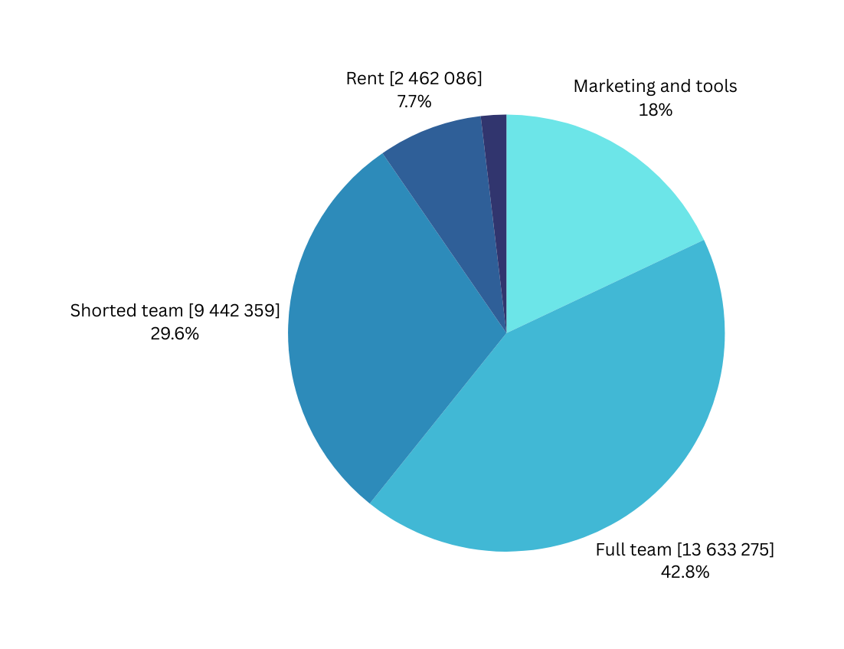
FULL BUDGET FOR
PLATFORM
FOR FIRST YEAR, TOTAL: 31,567,719.36 KZT

Slide 7

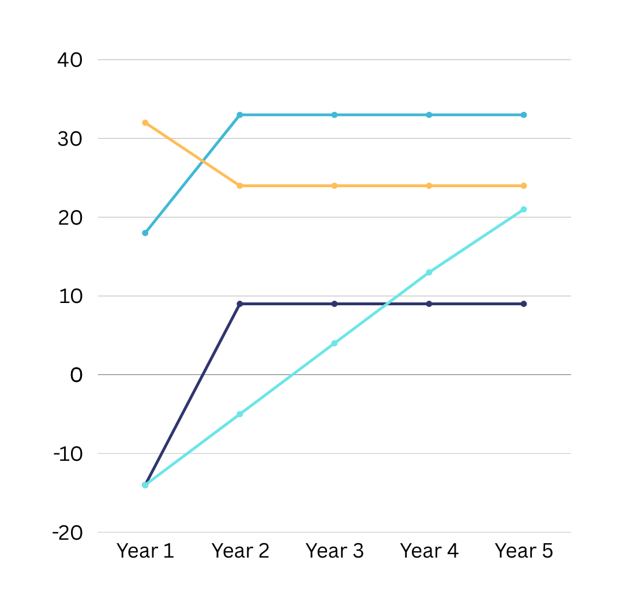
CASH FLOW
By observing the cash flow chart, you can clearly track the success of the project.
Although, like many startups, it is unprofitable in the first two years, but by the middle of the third year it pays off completely, and by the end of it, it begins to bring in additional profit.
In the future, the cumulative flow also accumulates successfully. Based on this, we can understand that the project data is as follows:
IRR - 52%
NPV - 7,832,464 KZT.
At a rate of 16.5%, this is a success.

Slide 8


THANK YOU
SUPPORT US
+7 777 491 13 80
mrkojieco@gmail.com

